Slide 1
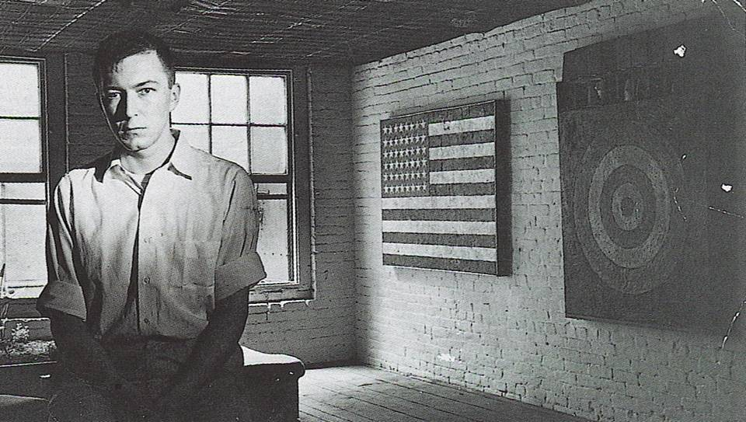
JASPER JOHNS
Born May 15, 1930 in Augusta, Georgia

Slide 2
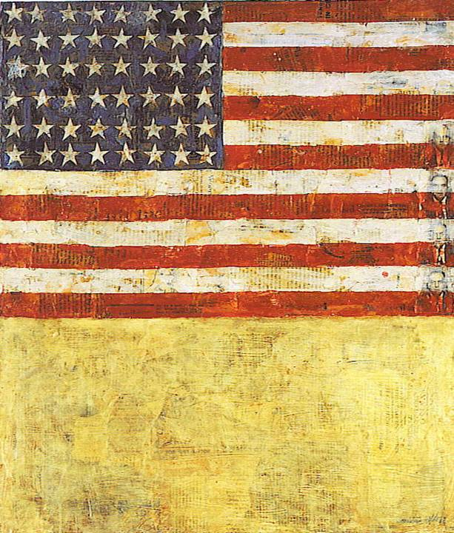
Flag above White with Collage, 1955

Slide 3
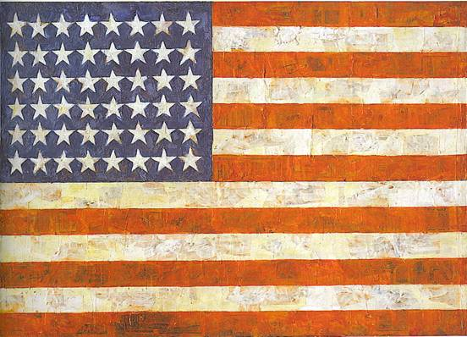
Flag, 1954 - 1955

Slide 4
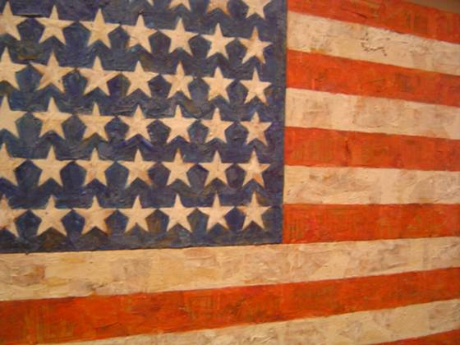
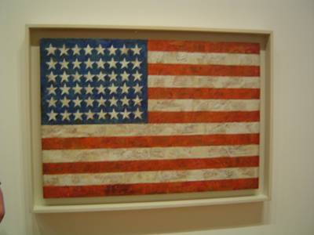
Snapshots from Museum of Modern Art, New York

Slide 5
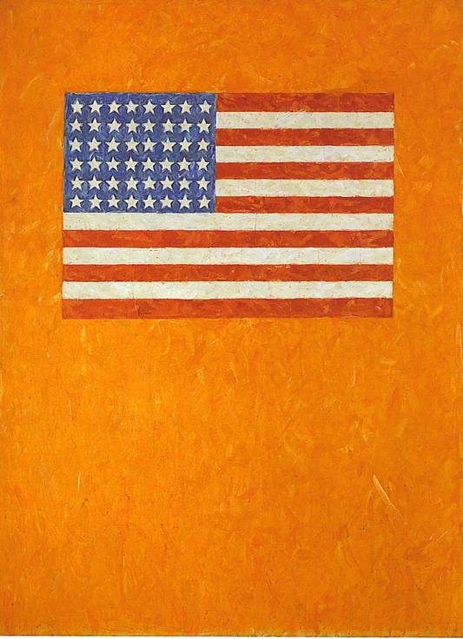
Flag on Orange Field , 1957

Slide 6
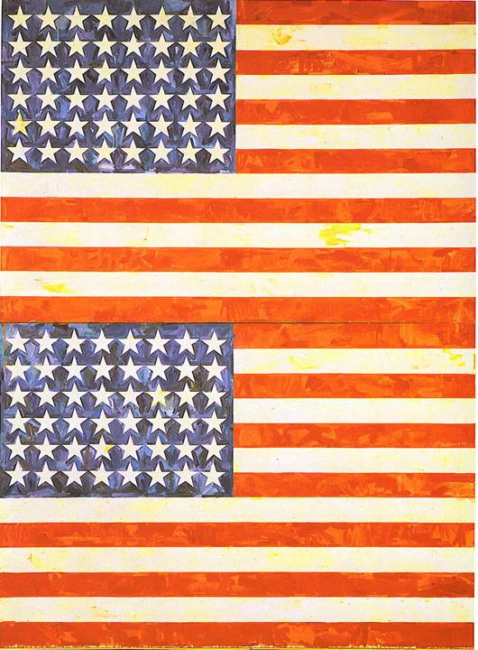
Two Flags, 1962

Slide 7
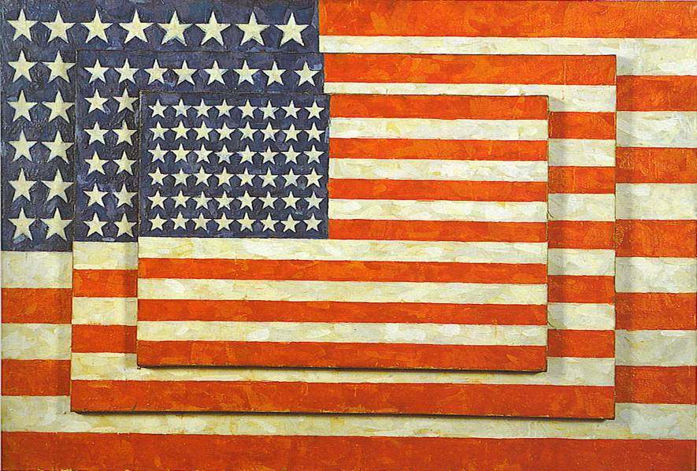
Three Flags, 1958

Slide 8
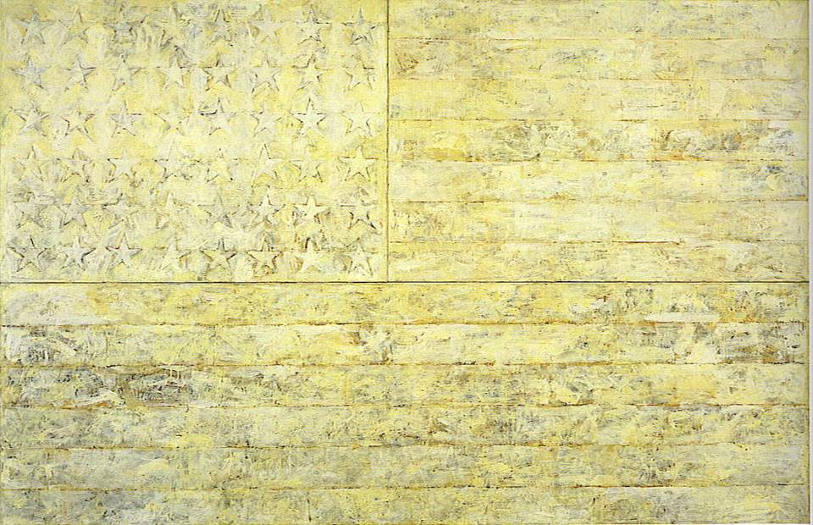
White Flag, 1955

Slide 9
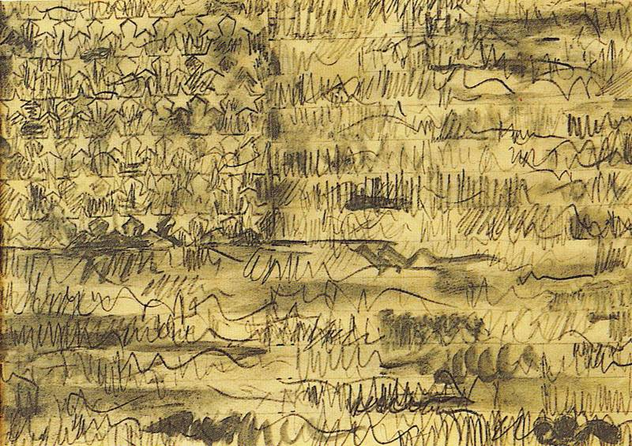
Flag (Drawing), 1958

Slide 10
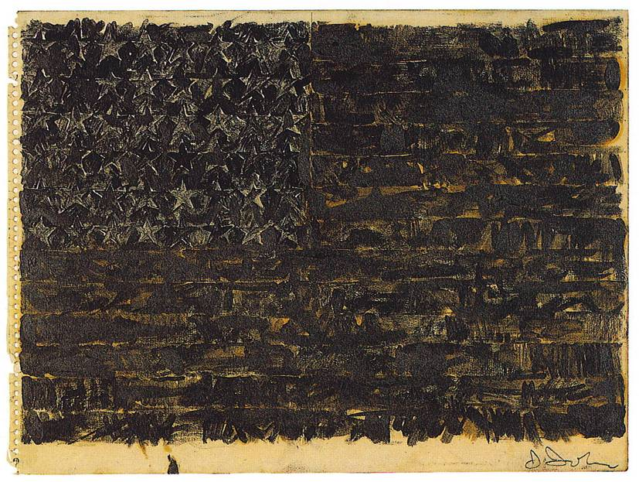
Flag, 1959

Slide 11
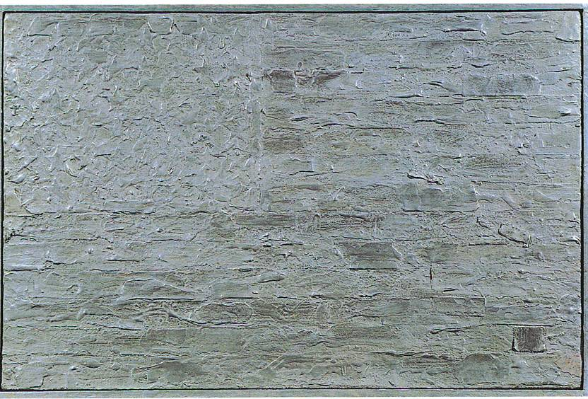
Flag, 1960

Slide 12
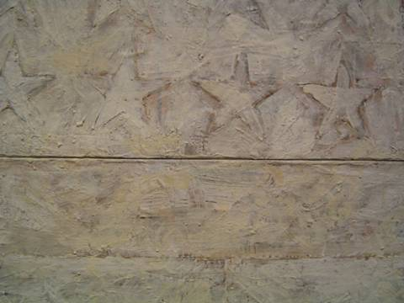
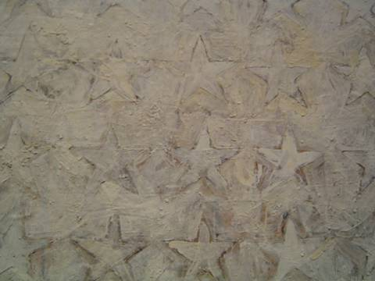
Snapshots from the Metropolitan Museum of Art, New York

